Slide 1
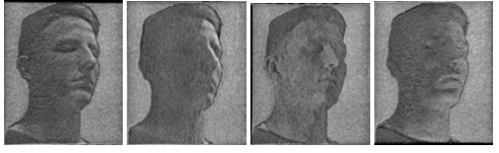
SHADOWPIX: Multiple Images from Self Shadowing
Amit Bermano Ilya Baran Marc Alexa Wojciech Matusk
Disney Research Zürich ETH Zürich TU Berlin MIT CSAIL Disney Research Boston

Slide 2
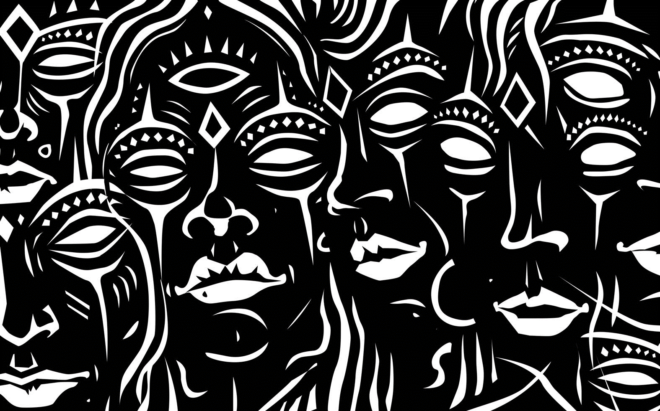
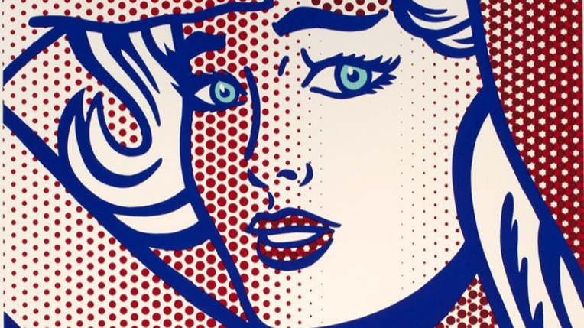
What if we want...
+
Pilpeled
Roy Lichtenstein
Notes:
לקחת 2 תמונות ולשים אותם באובייקט אחד

Slide 3
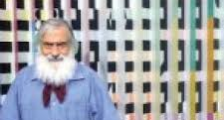
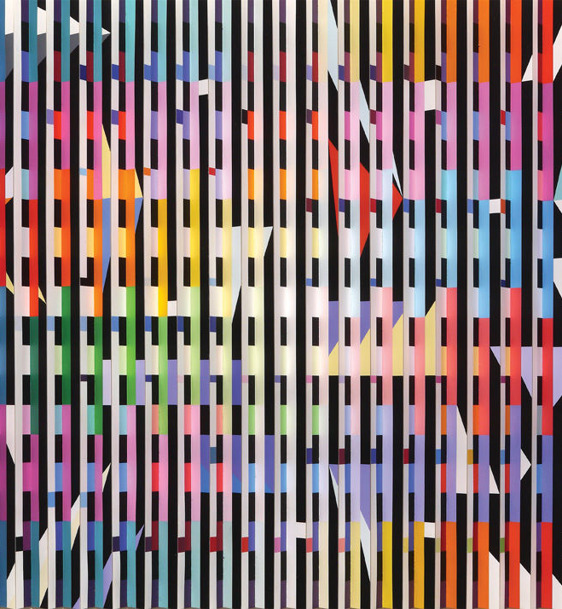
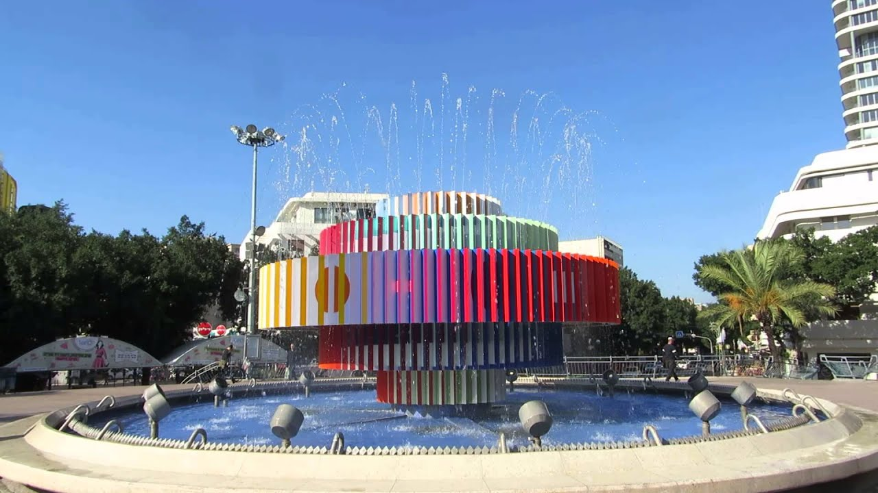
Yaacov Agam
Notes:
משתמש במימד השלישי עי קיפול של הדף כמו מניפה וציור של דברים שונים מכל צד

Slide 4
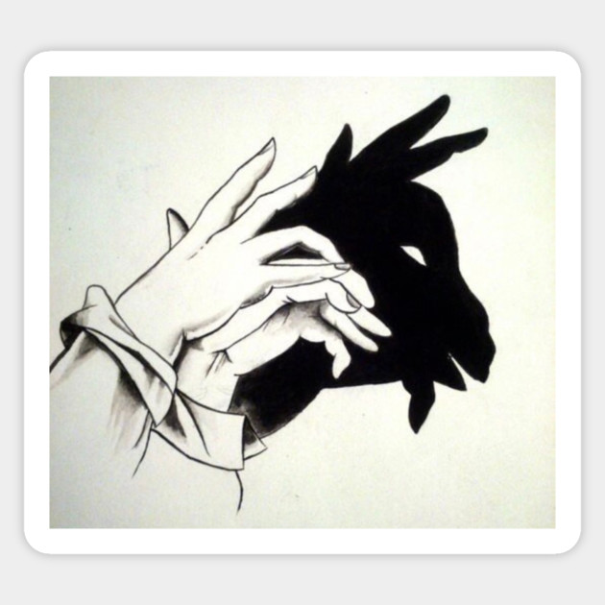
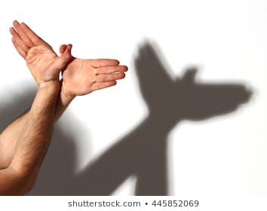
And what if we also want
Notes:
ומה אם בא לנו גם לעשות תמונות בעזרת צל

Slide 5
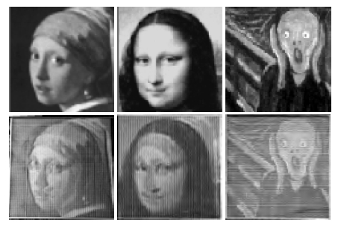
ShadowPix
Notes:
הסבר שבכל אחת מהתמונות מאירים על אותו החפץ מכיוון אחר והצל שעל החפץ בצורה של התמונה

Slide 6
Solution
Local Method
Global Method

Slide 7
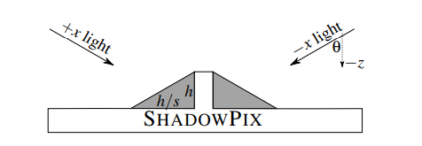
General Settings
The ShadowPix plane is parallel to the xy plane
Light sources are directional, all form an angle θ with the z axis
s = cotθ
Depends only on the setup of the lights
Element of height h casts a shadow of length h/s

Slide 8
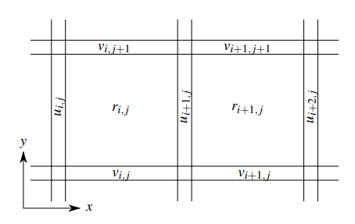
Local Method - Overview
Uses a grid corresponding to the pixels of the input images
Distinguishes between shadow receivers and walls casting shadows
Can handle up to three different input images
3 different light directions (+x, −x, and +y) which are aligned with the grid of elements
The shadow receivers are arranged as a grid of unit squares to match the pixels of the images

Slide 9
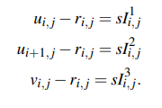
Local Method - Equations
r_{i,j} < min(u_{i,j} ,u_{i+1,j} , v_{i,j} , v_{i,j+1})
Make sure that only the walls are casting shadows
s.t
for –x and +x: |u_{i,j} − u_{i+1,j}| < s
Shadows are contained only in the pixels adjacent to the walls
for +y direction: v_{i,j} − v_{i,j+1} < s
Θ
H=sI¹_{ij}
Un-shadowed fraction
u_{ij}
H / s = I¹_{ij}
r_{ij}
The un-shadowed fraction of each square from each light direction is the relevant grayscale value
Notes:
If the left wall is with height of s, then the entire receiver is shadowed (H/s=1). Therefore, if the right wall is 0 height, then the next receiver is starting to be shadowed by the left wall. Shadow remains while the height diff is at least s.

Slide 10
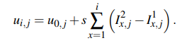
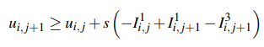
Local Method Optimization
r_{ij} < min(u_{i,j}, u_{i+1,j})
First scan line
|u_{i,j} − u_{i+1,j}| < s
The height increase is necessary to prevent a part of the surface closer to the +y light direction from shadowing a part of the surface farther from the light direction
r_{i,j} ≤ v_{i,j+1}
We just walk along a scan line, starting at u_{0,j} and determine the values of u_{i,j}.
As we would like to minimize the height, we pick u_{0,0} = 0 and incrementally pick u_{0,j} to be the smallest nonnegative value that still satisfies the inequality for all i.
In this setup, no degrees of freedom are left for a fourth image.
This method can reproduce any three images for the idealized case of an orthographic viewer and unconstrained height differences.
Notes:
You can get the combined equation by the first two equations by subtraction. The third equation is fulfilled by the first two equations (play with them). The forth equation is fulfilled by the combined equation (easy to see). The fifth equation is given by combining previous slide equations with rij <= vi,j+1

Slide 11
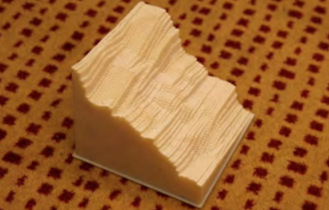
Local Method - Non-Ideal Settings
Viewer is at a finite distance (perspective view)
There are practical limitations of the construction process
Too tall to be usable

Slide 12
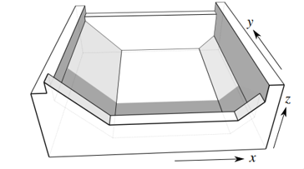
Local Method – Chamfering Overview
We need to limit variation in height
Additional height constraints to limit variation may be added
DOF in the pixel model is too small to improve significantly.
Chamfers to the +x and −x edges are added
Results with a maximum height of ~1 cm for an 20x20cm image.
Additional degrees of freedom that affect the +x and −x images independently.
Contradict the assumption of a parallel surface
Using a 3D printer their reflectance behaves as expected.

Slide 13
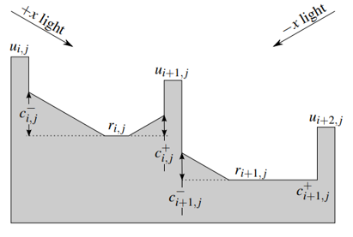
Local Method – Chamfering Overview (2)
Chamfers are parallel to the opposite light directions
Chamfer lit by only one direction
Chamfers potentially lit and are brighter than the base of the pixel because their normal is closer to the light directions.
Shorten the shadows of their respective lights.
Increasing c⁻_{i,j}:
brightens the i,j pixel when lit by the −x light
has no effect on the +x light configuration.
= 0
Notes:
Our algorithm would never actually produce this configuration of c⁺_{i+1,j}=0, because c⁻_{i,j} could be increased further, allowing u_{i+1,j} and therefore r_{i+1,j} to increase.

Slide 14
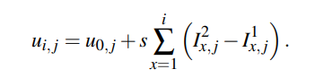
Local Method – Chamfering Optimization
Suppose we computed row j using
assuming u_{0,j} = 0.
For each pixel in each row (increasing order):
If r_{i+1,j} > r_{i,j} then increase c⁺_{i+1,j}
brightens pixel i+1,j lit by the +x light
allowing to lower r_{i+1,j} and all u’s and r’s to the right of it and keep illumination unchanged while reducing variation.
until either r_{i+1,j} = r_{i,j} or c⁺_{i+1,j} = u_{i+2,j} −r_{i+1,j}.
Else increase c⁻_{i,j} and raise u_{i+1,j} , r_{i+1,j} and all of the r’s and u’s to their right
Until r_{i+1,j} = r_{i,j} , or when c⁻_{i,j} = u_{i,j} − r_{i,j} , or when the chamfers collide and c⁻_{i,j} + c⁺_{i,j} = s

Slide 15
Local Method – Chamfering (+y direction)
Chamfers make a pixel potentially less bright when lit by the +y light
The dot product of the +y direction with the normal of a chamfer is smaller than with the normal of the pixel floor
Computing v’s compensates, but in some cases even when the pixel is completely un-shadowed, it ends up insufficiently bright due to the chamfers
The solution is to uniformly reduce the brightness of I³ (usually no more than 10%)

Slide 16
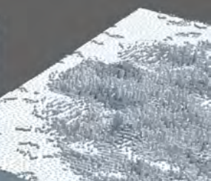
Global Method
The shadowPix is a simple heightfield grid where each element (pixel) is of the same size
Each element can both cast and receive shadows
Each element is either completely shadowed or not (no grayscale)
Can accommodate an arbitrary number of images
Solved as an optimization problem

Slide 17
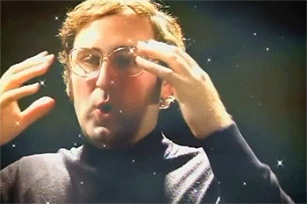
Convolution
convolution is a mathematical operation on two functions that produces a third function expressing how the shape of one is modified by the other
Mind blowing fact: Images are functions from 2D to color space
Each pixel in the output image is a weighted average of it’s surrounding pixels
The weights are called a kernel or filter

Slide 18
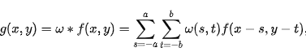
K
*
Image
=
Result

Slide 19
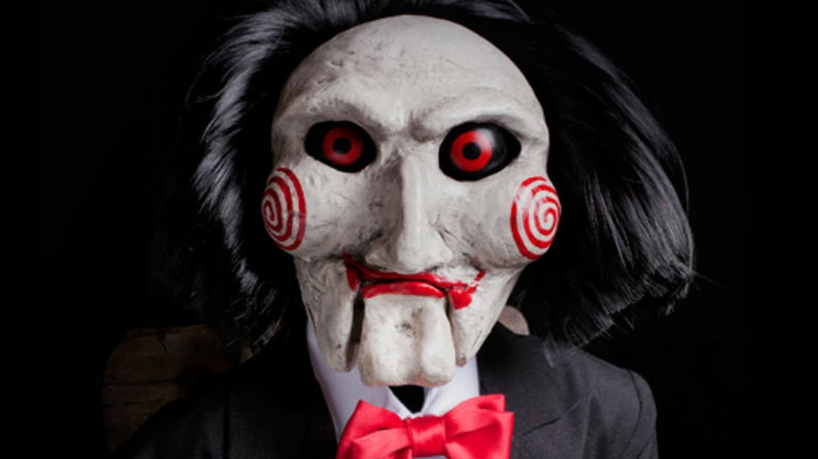
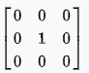
I want to play a game
=
*

Slide 20
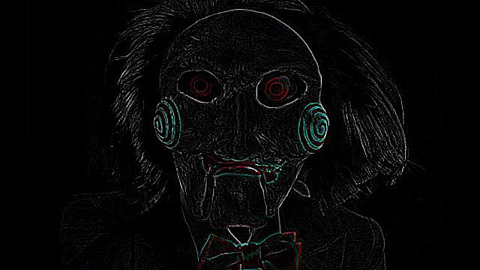
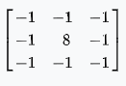
I want to play a game
=
*

Slide 21

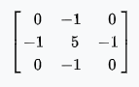
I want to play a game
=
*

Slide 22

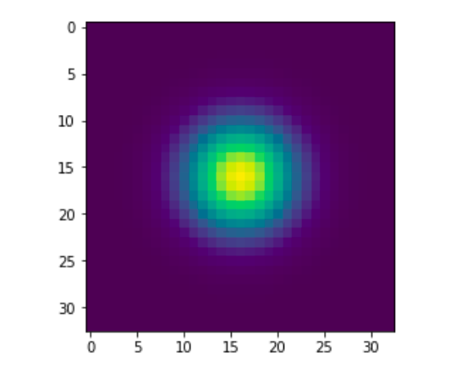
I want to play a game
=
*

Slide 23
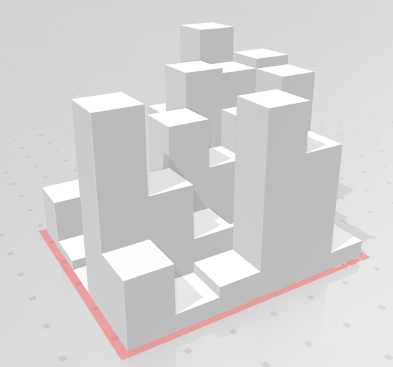
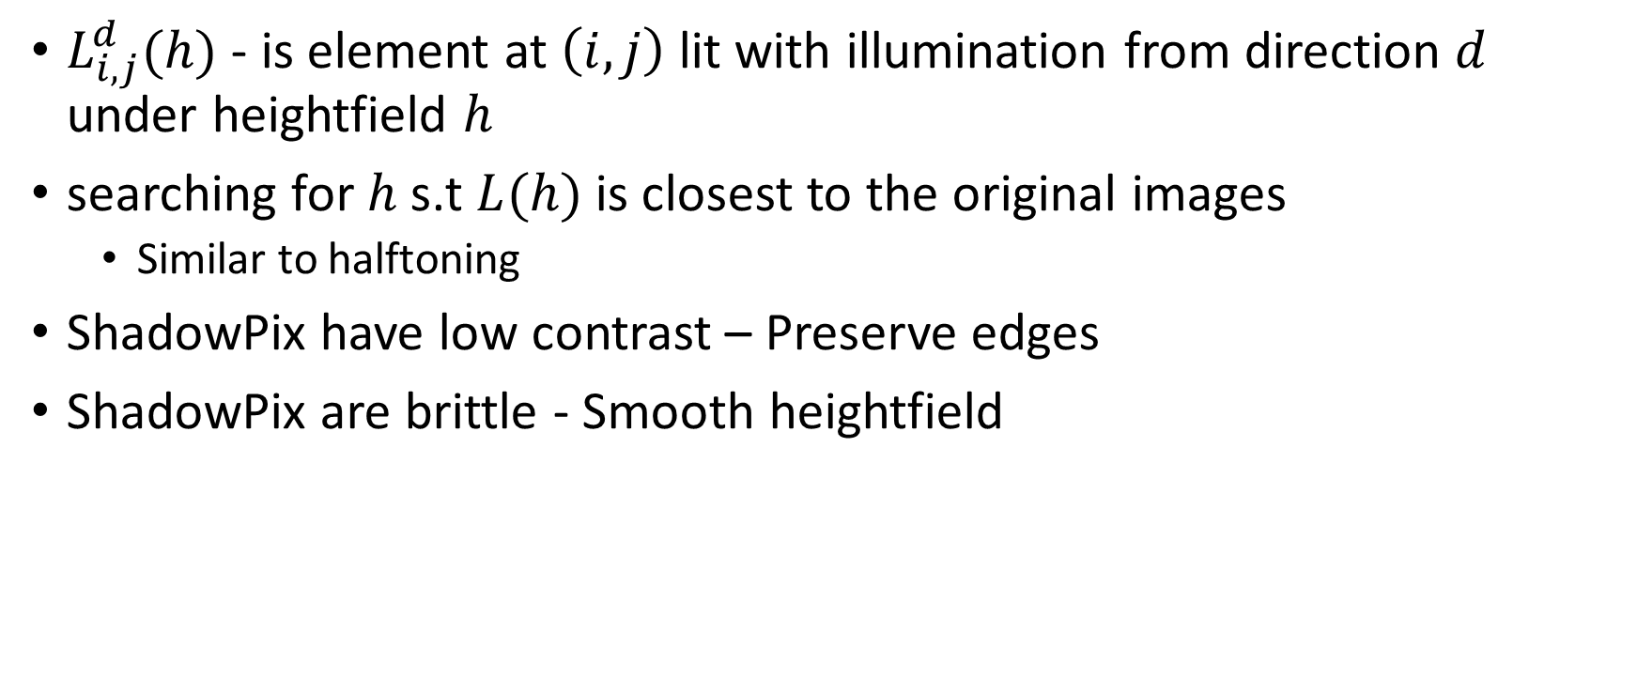
Finding the heightfield – what to optimize
$L_{i,j}^{d}(h)$ - is element at $\left(i,j\right)$ lit with illumination from direction $d$ under heightfield $h$
searching for $h$ s.t $L(h)$ is closest to the original images
Similar to halftoning
ShadowPix have low contrast – Preserve edges
ShadowPix are brittle - Smooth heightfield

Slide 24
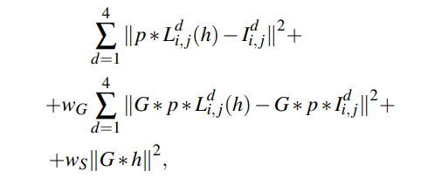
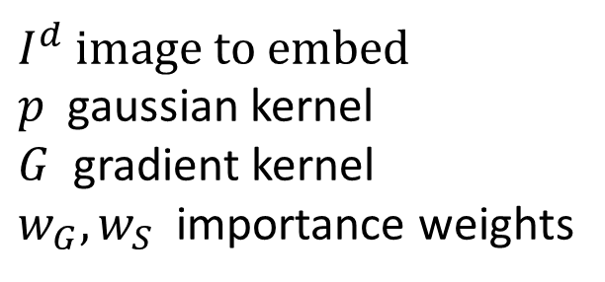
Function to minimize
$I^{d}$ image to embed
$p$ gaussian kernel
$G$ gradient kernel
$w_{G}, w_{S}$ importance weights
Similarity term
Edge preserving term
Smoothening term

Slide 25

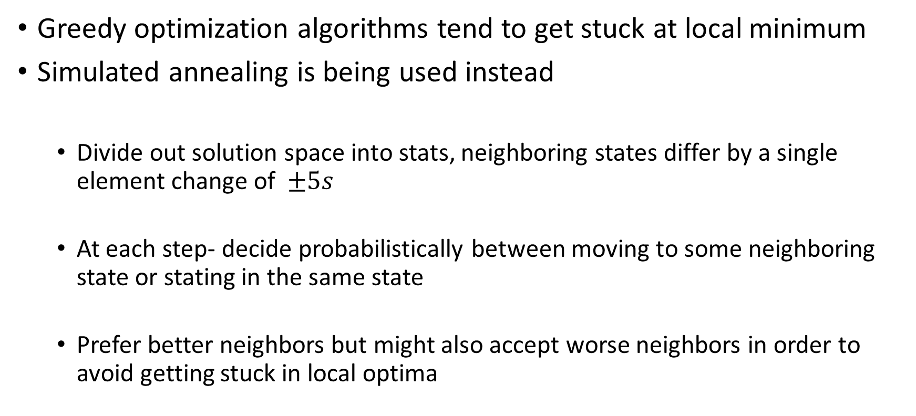
Finding $h$
Greedy optimization algorithms tend to get stuck at local minimum
Simulated annealing is being used instead
Divide out solution space into stats, neighboring states differ by a single element change of $±5s$
At each step- decide probabilistically between moving to some neighboring state or stating in the same state
Prefer better neighbors but might also accept worse neighbors in order to avoid getting stuck in local optima
Notes:
- Every heightfield element of height hs, will cast a shadow whose length is at most h pixels. Because of this, each height change affects the blurred image only within a radius r, where r is the maximum of the height before and after the change (but at most 10) plus the radius of the blur kernel p. The effects of changing heightfield elements more than 2r apart are therefore guaranteed to be independent. Therefore, at every step, we pick multiple heightfield elements at distances at least 2r from each other. We pick as many elements as we have cores and in parallel process the effect on the objective function of changing each of them.

Slide 26
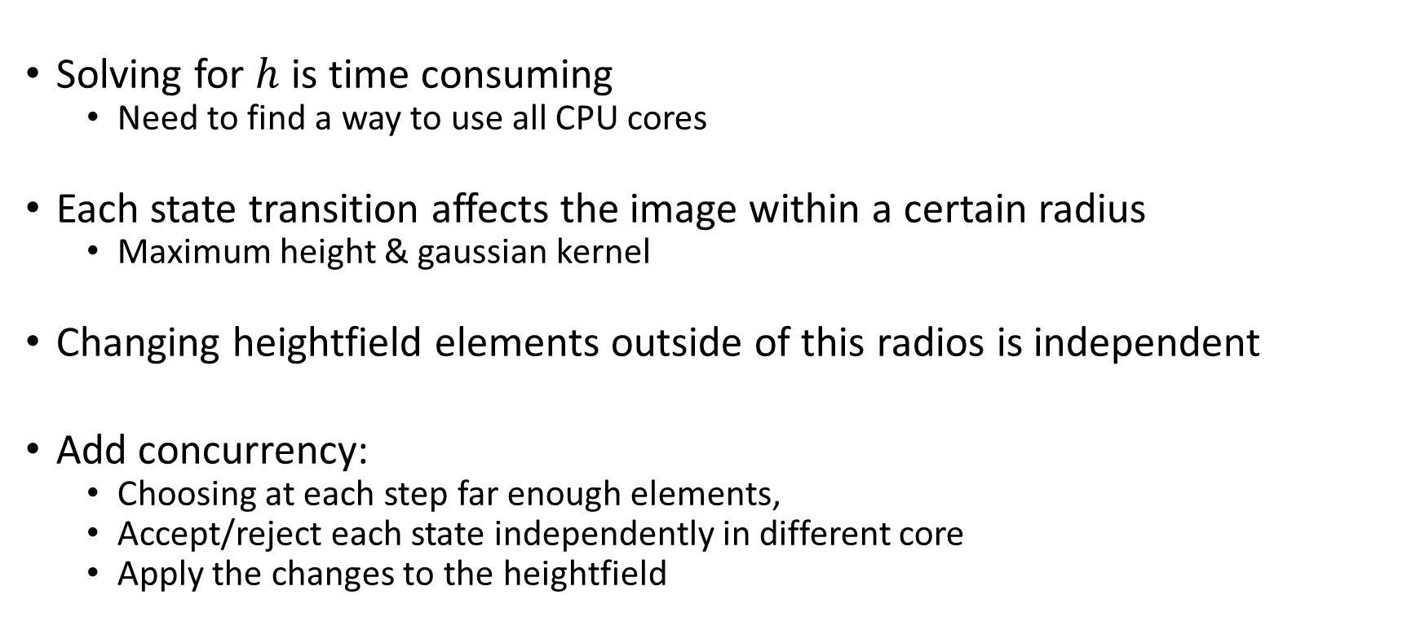
Simulated annealing improvements
Solving for $h$ is time consuming
Need to find a way to use all CPU cores
Each state transition affects the image within a certain radius
Maximum height & gaussian kernel
Changing heightfield elements outside of this radios is independent
Add concurrency:
Choosing at each step far enough elements,
Accept/reject each state independently in different core
Apply the changes to the heightfield

Slide 27
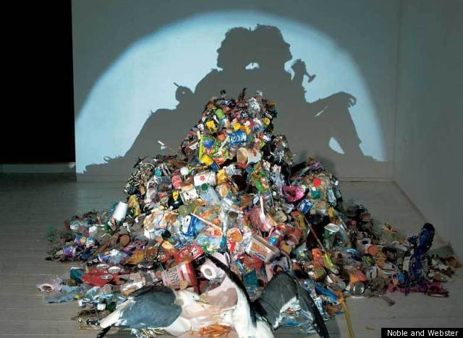
Related Work
shadow sculptures assembled by trial and error by artists
Recent algorithmic methods: Shadow art by MITRA N. J
Computational tools for the creation of shadow art
Shape from darkness: Deriving surface information from dynamic shadows by KENDER J
single cross section
Shadow Graphs and Surface Reconstruction by YU Y.
Reconstruct shape from shadows
Model-based halftoning using direct binary search by ANALOUI M.
optimization-based halftoning
What's new with ShadowPix:
Halftone
Elements cast and receive shadow
Tim Nobel and Sue Webster

Slide 28
Results Settings
Local Method:
Pixel size of 2.5x2.5 mm
Wall thickness of 0.25 mm
Global Method:
Element size of 0.5x0.5 mm
Thinner heightfield elements tend to bend or break
Printing:
Objet Connex 350 printer
VeroBlack (opaque black material), painted white with an airbrush.
Samples varied between 10 and 20 centimeters in each dimension

Slide 29
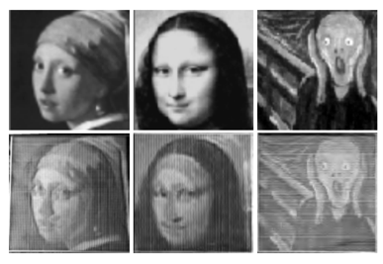
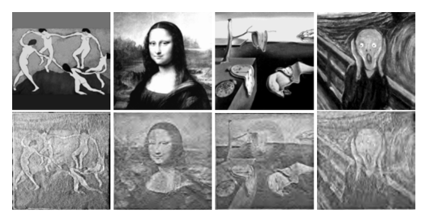
Results - Paintings
Inputs:
Printed ShadowPix
(Local Method):
Inputs:
Printed ShadowPix
(Global Method):

Slide 30
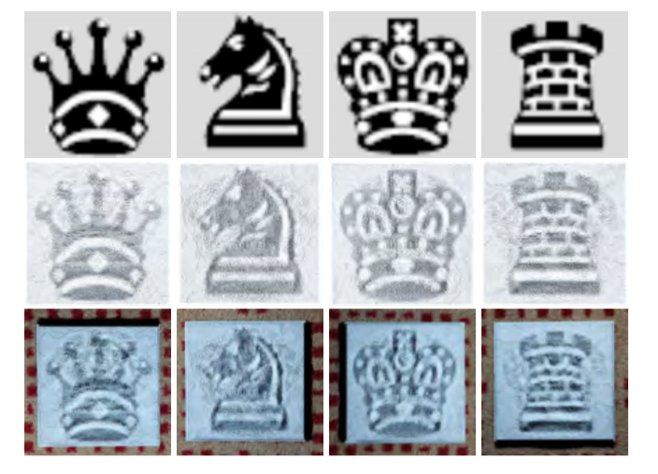
Results - Chess
Inputs:
Renderings:
Printed ShadowPix
(Global Method):
challenging due to the extreme brightness differences.
View and light directions perturbed on the printed version.
Rendering captures all features up to color balance.

Slide 31
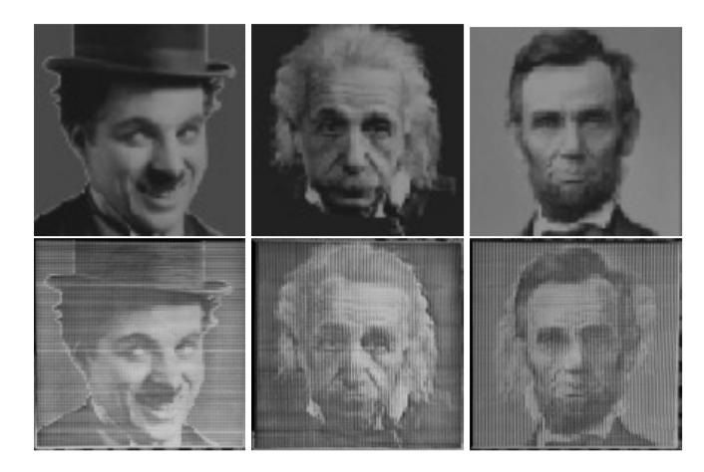
Results – Photographs
Inputs:
Printed ShadowPix
(Local Method):

Slide 32
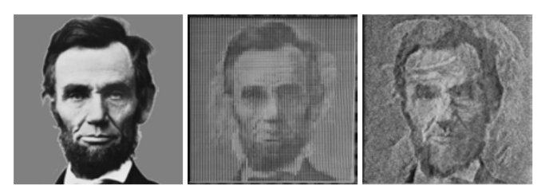
Results – Photographs (2)
Input
Local Method
Global Method
Local Method:
Less noisy
Less ghosting
Less sensitive to light and viewing directions
Global Method:
Higher resolution
Better contrast
4 images

Slide 33
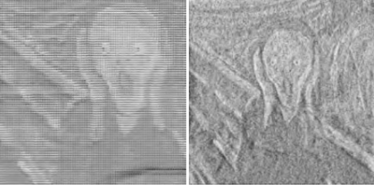
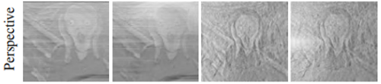
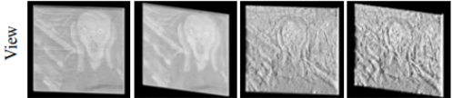
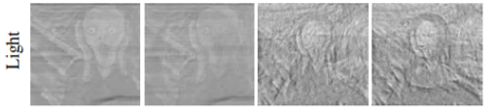
Results - Stability
Local Method
Global Method
Local Method
Global Method
Perspective camera, 50◦ and 100◦ FOV
Orthographic camera, light at the correct angle
Local Method
Global Method
Local Method
Global Method
Orthographic camera, 15◦ and 30◦ view direction
Orthographic camera, 20◦ and 40◦ light direction
Physically-based rendering
The local method is significantly more tolerant to deviations

Slide 34
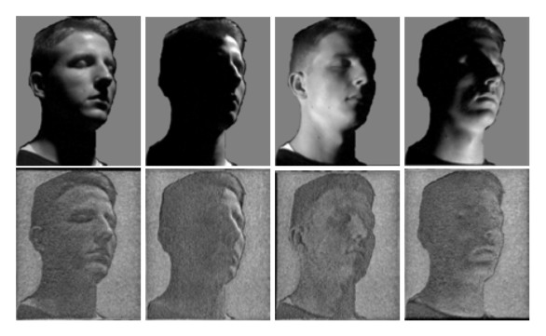
Results – Opposite Direction Lighting Effect
Inputs:
Printed ShadowPix
(Global Method):
Image appears as if lit from the opposite direction than the actual light direction

Slide 35
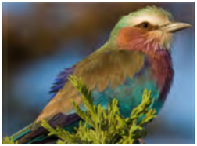
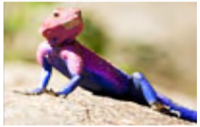
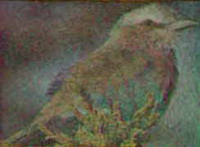
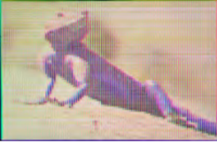
Results - RGB
Input
Input:
Global Method
Local Method:
Single channel images were encoded using SW
Illuminated by colored lights from 3 directions
Notes:
Alexa and Matusik [AM10] have done a similar experiment, but their method is limited to two color channels, which is insufficient for most color images.

Slide 36
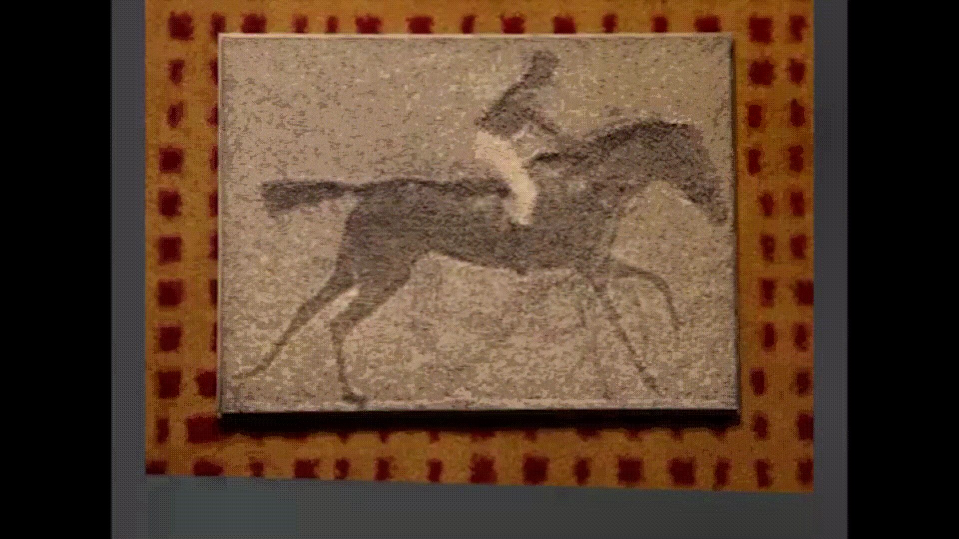
Results - Animation

Slide 37
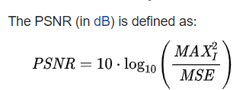

Results – PSNR for Global Method
(db)
(dB)
Multiple Runs Of Simulated Annealing Opt.
Greedy Opt.
Chess pieces example
PSNR between the input image and the output bitmap convolved with the point spread function p (for image quality).
Greedy converges faster but with lower performance (3 dB)
Quality is independent of the initial condition
Random choices made during a run.

Slide 38

Results – Number of Images
Image quality as the function of number of images.
For the global method, images were added for the four diagonal light directions (±x,±y)
Modification to the objective function, shadows are calculated on four quarters of each pixel.
Quality is decreasing as more images are added.
Different curves for different random orders
order has a significant influence

Slide 39
Results - Runtime
Local method:
~6 seconds to run for heavy examples
Global method takes a couple of hours to run
~29 minutes for the chess pieces
~104 minutes for the paintings example.
~2 – ~6 hours to print
~2 hours for cleaning and painting
Utilizes all cores
Both methods requires a negligible amount of memory

Slide 40
Future Work
Explore different geometric primitives for the local method (e.g. hexagonal grid).
Develop fast deterministic algorithm for the global method.
Authors suspects that interreflections between parts of the white surface are responsible for some of the ghosting and contrast reduction
Take into account global illumination
Explore different manufacturing methods
Rapid prototyping methods were used
Try injection molding and CNC milling
Add additional degrees of freedom in order to encode more images and preserve quality
Geometry (e.g. self shadowing, surface normals, etc.)
Reflectance (e.g. diffuse, glossy, specular effects, etc.)
Non-planar surfaces can broaden the range of possible applications.

Slide 41


